Slide 1
Commodity Price Forecasting
By Gopalakrishnan Kumar, MTech IIT-Bombay,
Freelance Data Science Consultant
LinkedIn: Profile Link : https://www.linkedin.com/in/gopalakrishnankumar-a73301110/
Github:https://www.github.com/Gopalakrishnan-Kumar/
Kaggle URL- https://www.kaggle.com/gopalkk2

Slide 2
Google Colab URL
https://colab.research.google.com/drive/1vTu4BPX2Lls42QhIeVw5bZxIhV5pL57D?usp=sharing

Slide 3
Introduction
Commodity markets such as oil, gold, and agricultural products (corn, wheat, etc.) are
highly volatile and influenced by various global factors like supply-demand dynamics,
geopolitical events, and macroeconomic indicators. Accurate forecasting of
commodity prices helps investors, policymakers, and businesses make better decisions in terms of risk management, hedging, and inventory planning.
This project leverages time series forecasting (ARIMA model) to predict future commodity prices using historical datasets
(sourced from Yahoo Finance via yfinance).

Slide 4
Objective
The main goals of this project are:
Analyze historical commodity price patterns (Oil, Gold, Corn).
Visualize the distribution and trends of commodity prices.
Apply ARIMA (Auto-Regressive Integrated Moving Average) to forecast future prices.
Generate insights that can help in strategic decision-making.

Slide 5
Objective
The main goals of this project are:
Analyze historical commodity price patterns (Oil, Gold, Corn).
Visualize the distribution and trends of commodity prices.
Apply ARIMA (Auto-Regressive Integrated Moving Average) to forecast future prices.
Generate insights that can help in strategic decision-making.

Slide 6
Dataset
Source: Yahoo Finance (yfinance library)
Period: 2015 – 2025 (10 years of daily prices).
Commodities used:
Crude Oil (WTI) → CL=F
Gold Futures → GC=F
Corn Futures → ZC=F
Each dataset contains:
Date (daily frequency)
Open, High, Low, Close, Adjusted Close, Volume
For analysis, we used Adjusted Close as the reliable price measure.

Slide 7
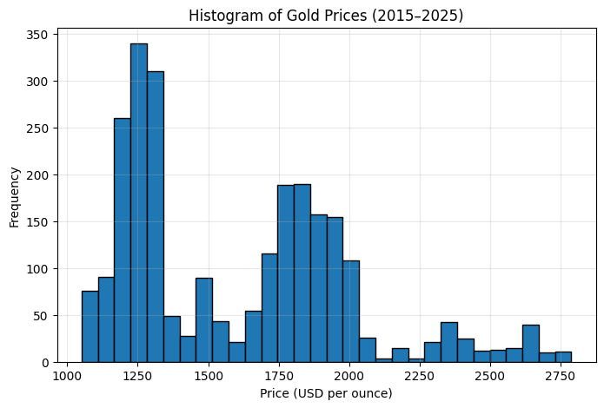
Data Visualization

Slide 8
Exploratory Data Analysis (EDA)
📊 Histogram
Histograms show the distribution of commodity prices.
Gold prices (2015–2025) mostly fall between $1,200 and $2,000 per ounce, showing periods of high volatility.
Oil prices are more volatile, ranging from below $40 to over $100 per barrel.
Corn prices are comparatively stable, mostly ranging between $300 and $700 per bushel.

Slide 9
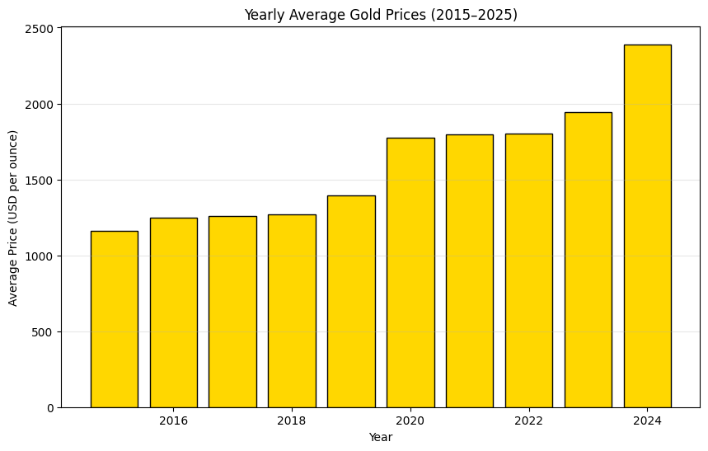
Data Visualization

Slide 10
Exploratory Data Analysis (EDA)
📊 Bar Chart (Yearly Averages)
Yearly average prices highlight long-term trends.
Gold shows a steady upward trend after 2019, influenced by inflation concerns and safe-haven demand.
Oil shows sharp fluctuations due to geopolitical shocks and COVID-19 (2020 saw extremely low prices).
Corn shows cyclical peaks, influenced by seasonality and supply shocks.

Slide 11
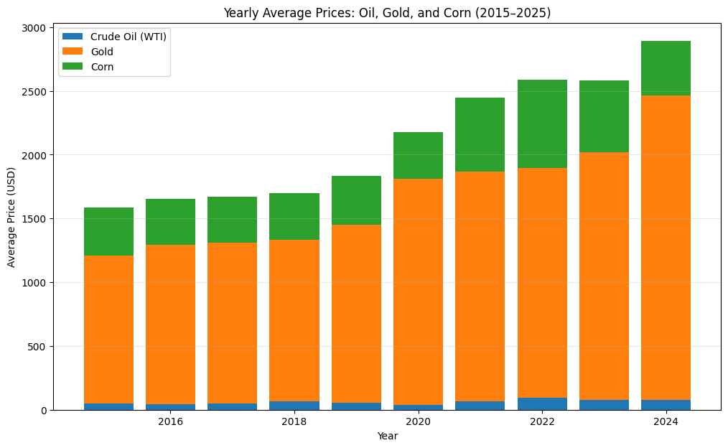
Data Visualization

Slide 12
Exploratory Data Analysis (EDA)
📊 Stacked Bar Chart
Stacked bars showed the combined yearly averages of oil, gold, and corn.
Revealed how much each commodity contributes to the overall basket of prices.

Slide 13
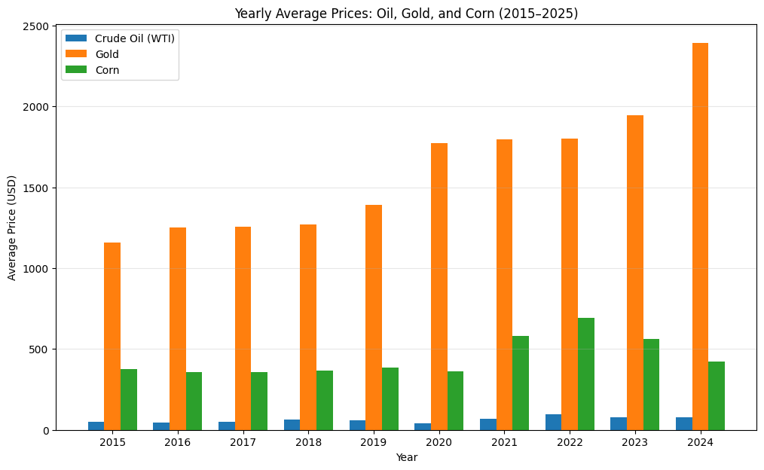
Data Visualization

Slide 14
Exploratory Data Analysis (EDA)
📊 Combined (Grouped) Bar Chart
Placed Oil, Gold, and Corn prices side by side for each year.
Clear comparison → In 2022–2023, gold remained high, oil peaked in 2022 due to global supply chain disruptions, and corn saw a rise due to global food security concerns.

Slide 15
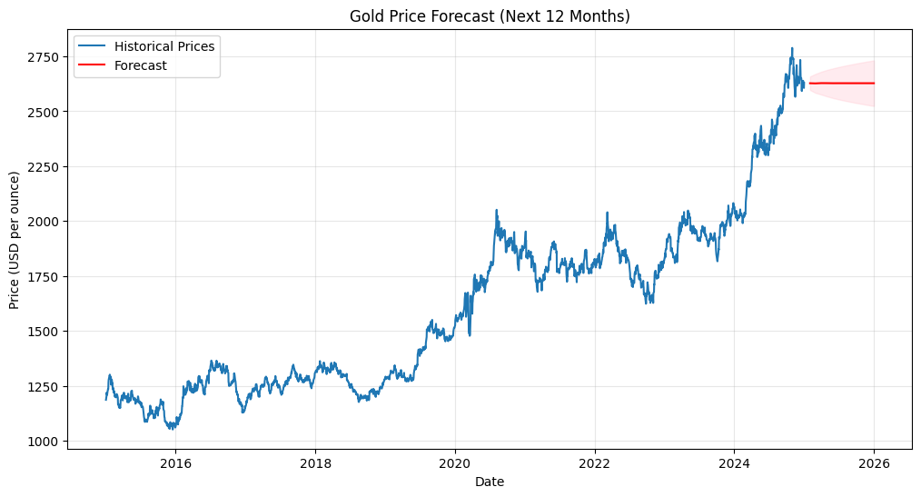
Data Visualization

Slide 16
Forecasting with ARIMA
Model Used:
ARIMA(p, d, q) where:
p: number of lag observations (autoregression).
d: degree of differencing (to remove trend).
q: size of moving average window.
For Gold, ARIMA(5,1,0) gave a good fit.
Forecast Plot
Historical prices (2015–2025) plotted in blue.
ARIMA model forecasts 12 months ahead.
Red line = forecasted mean values.
Pink shaded area = 95% confidence interval (uncertainty in prediction).

Slide 17
Forecasting with ARIMA
Key Insights:
Gold is forecasted to remain stable but gradually rising over the next year.
Oil prices show higher volatility, with wider confidence intervals.
Corn remains relatively stable but still impacted by supply shocks.

Slide 18
Insights and Business Implications
Investors → Can use gold forecasts as a hedge against inflation.
Energy companies → Oil price predictions help in production planning
and hedging contracts.
Agriculture sector → Corn forecasts support inventory planning and
supply chain optimization.
Policy makers → Forecasts can guide inflation control measures since commodities
directly affect CPI.

Slide 19
Limitations
ARIMA works well for short-term forecasts but may struggle with
long-term structural changes.
Commodity prices are influenced by external shocks
(wars, pandemics, natural disasters)
that cannot be fully captured by statistical models.
Using only historical prices ignores macroeconomic drivers
like interest rates, inflation, and demand.

Slide 20
Future Work
Use SARIMA to incorporate seasonality (especially for agricultural commodities).
Apply Prophet (Facebook) or LSTM (Deep Learning) for better accuracy.
Integrate macroeconomic indicators (interest rates, inflation) into the forecasting model.
Build an interactive Power BI / Tableau dashboard for real-time commodity forecasting.

Slide 21
Conclusion
This project successfully demonstrated how time series forecasting with ARIMA can predict future commodity prices such as oil, gold, and corn. The analysis revealed:
Gold prices remain a stable upward trend as a safe-haven asset.
Oil prices are highly volatile and sensitive to global shocks.
Corn prices show seasonal and supply-driven cycles.
Such forecasting models can be highly valuable for investors, businesses, and policymakers in making informed decisions.

